Slide 1
Network Design and Devices

Slide 2
Network Devices and Network Design

Slide 3
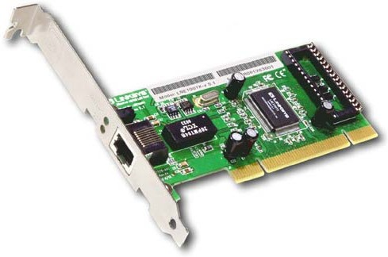
Network Devices
Local Area Network Card

Slide 4
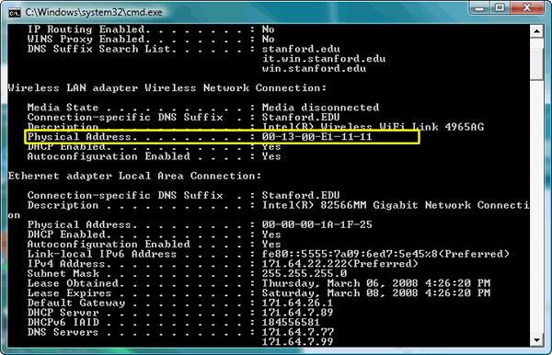
MAC Address

Slide 5
MAC Address
A Media Access Control address (MAC address) addresses are most often assigned by the manufacturer of a network interface card (NIC) and are stored in its hardware
the card's read-only memory, or some other firmware mechanism
Q: Can we change MAC address

Slide 6
MAC Address
For example, an address in canonical form 12-34-56-78-9A-BC
01001000 00101100 01101010 00011110 01011001 00111101

Slide 7
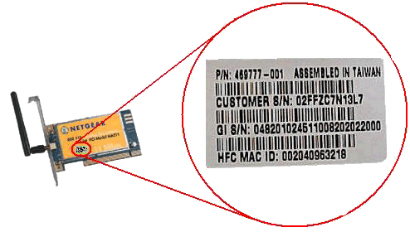

Slide 8
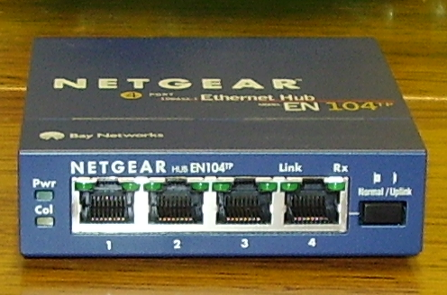
Hub

Slide 9
Network Hub
http://www.youtube.com/watch?v=IwqUmXu8kv0

Slide 10
Hub
Multiple repeater

Slide 11
Switch
Connects Network segments
Intelligent compare to Hub
1990 came the first switch Kalpana
In the case of a "hub," they would all share the bandwidth and run in Half duplex, resulting in collisions

Slide 12
Types of Switch
Layer 2 Switch
Layer 3 Switch

Slide 13
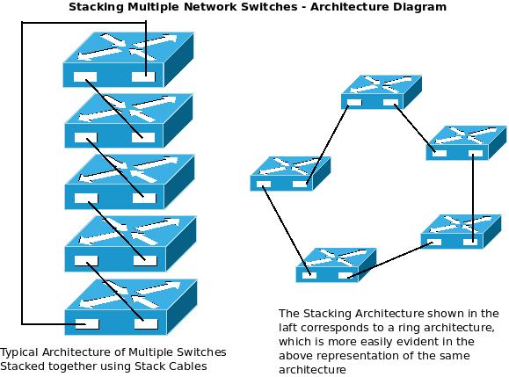
The Stack Switch Concept

Slide 14
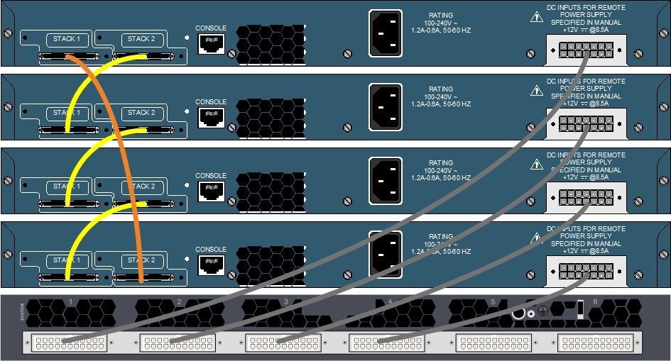
Example

Slide 15
Router
interconnects two or more computer networks

Slide 16
Router
What Is the Difference Between Hubs & Routers?
http://www.youtube.com/watch?v=gzU3a4WE0EQ&feature=channel

Slide 17
Media Converter?

Slide 18
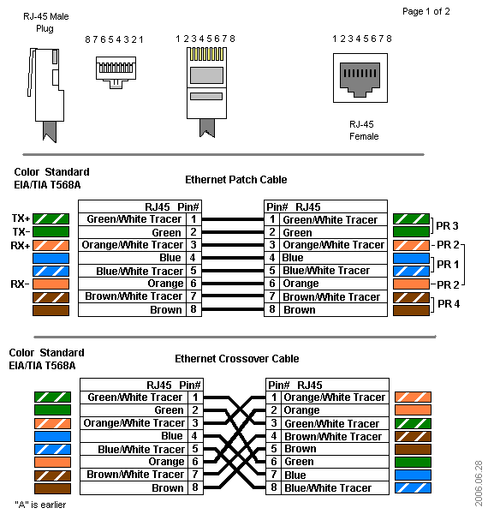
RJ 45

Slide 19
Straight Cable

Slide 20
Cross Over Cable

Slide 21
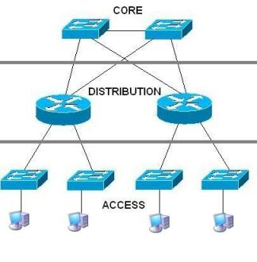
Hierarchal Model of Network

Slide 22
Cisco’s Hierarchical Design Model
A core layer of high-end routers and switches that are optimized for availability and speed.
A distribution layer of routers and switches that implement policies and segment traffic
An access layer that connects users via hubs, switches, and other devices

Slide 23
Why Use a Hierarchical Model?
Reduces workload on network devices
Avoids devices having to communicate with too many other devices (reduces “CPU adjacencies”)
Constrains broadcast domains
Enhances simplicity and understanding
Facilitates changes
Facilitates scaling to a larger size

Slide 24
When to use it?
Small company.. Approx. 30 nodes one branch office?

Slide 25
How Do You Know When You Have a Good Design?

Slide 26
How Do You Know When You Have a Good Design?
When you already know how to add a new building, floor, WAN link, remote site, e-commerce service, and so on
When new additions cause only local change, to the directly-connected devices
When your network can double or triple in size without major design changes
When troubleshooting is easy because there are no complex protocol interactions to wrap your brain around
Notes:
Said by Dr. Peter Welcher, consultant and author of many networking articles in magazines, etc.

Slide 27
Question
What happens if we implement policies at the core layer?

